Slide 1
Queues

Slide 2
Introduction
A Queue is a linear data structure in which insertion is done at one end called rear end and deletion at other end called front end.
Insertion-enqueue, Deletion-dequeue
Property- First In First Out (FIFO)
Types
Linear Queue
Circular Queue –operations like normal queue
DEQUE (Double Ended Queue) – enqueue and dequeue at both ends
Input restricted DEQUE – enqueue at rear end only but dequeue at both ends
Output restricted DEQUE-dequeue at front end only
Priority Queue(heaps)-dequeue at front but enqueue is based on priority

Slide 3
Applications
Simulation
Printing process
Queueing theory
Job scheduling
Interrupt handling
Compression techniques
Artificial intelligence
Graph algorithms

Slide 4
Array implementation of Linear Queue-Enqueue
void enqueue (int x)
{
if(rear==arraysize-1)
print(“Queue is full”)
else
{
rear=rear+1
queue[rear]=x
if(front==-1)
front=front+1//front=0
}
}
Initial values
front=-1
rear=-1
4 | 50
3 | 40
2 | 30
1 | 20
0 | 10

Slide 5
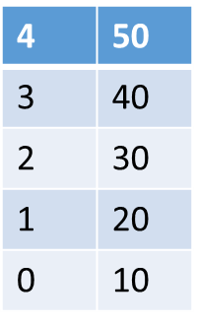
Linear queue-Dequeue
void dequeue ()
{
if(front==-1 && rear==-1)
print(“Queue is empty”)
else
{
print(“The dequeued element is”,queue[front])
if(front==rear)//when there is only one element in the queue
{front=-1
rear=-1}
else
front=front+1
}
}

Slide 6
Circular Queue-Enqueue
void enqueue (int x)
{
if(front==(rear+1)%arraysize) 4 0
print(“Circular Queue is full”) 3 1
else 2
{
rear=(rear+1)%arraysize
cqueue[rear]=x
if(front==-1)
front=front+1//front=0
}
}
Initial values
front=-1
rear=-1

Slide 7
Circular Queue-Dequeue
void dequeue ()
{
if(front==-1 && rear==-1)
print(“Circular Queue is empty”)
else
{
print(“The dequeued element is”,cqueue[front])
if(front==rear)//when the cqueue has one element
{front=-1
rear=-1}
else
front=(front+1)%arraysize
}
}

